Slide 1




INTRODUCTION TO ROUTERS
Router and Routing Basics
Version 3.0
Cisco Regional Networking Academy

Slide 2
Objectives
An introduction to the fundamentals of the IOS
Provide the tools and techniques for basic router configuration

Slide 3
Table of Content
1 | Operating Cisco IOS Software
2 | Starting a Router

Slide 4

OPERATING CISCO IOS SOFTWARE

Slide 5
The purpose of Cisco IOS Software
Basic routing and switching functions
Reliable and secure access to networked resources
Network scalability
Notes:
See 2.1.1

Slide 6
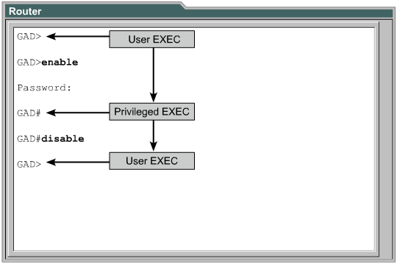
Router user interface modes
Notes:
See 2.1.2, 2.1.3
The Cisco IOS software uses a command-line interface (CLI) as the traditional console environment.
One way to access the CLI is through a console session.
Another way to access a CLI session is by use of a dialup connection using a modem or null modem connected to the router AUX port.
Another method of accessing a CLI session is to Telnet to the router.
As a security feature the Cisco IOS software separates the EXEC sessions into two access levels. These levels are user EXEC mode and privileged EXEC mode.
The user EXEC mode allows only a limited number of basic monitoring commands. The user EXEC level does not allow any commands that might change the configuration of the router.
The privileged EXEC mode accesses all router commands. m

Slide 7
Cisco IOS software features
IOS naming convention: xxxx-yyyy-ww
  xxxx: Platform.
  yyyy: Features.
  ww : Format.
Ex:C2500-I-L
  C2500: 25xx.
  I: IP subset (IP, SNMP, Bridging, WAN, Terminal services, Remote nodes).
  L: relocation.
Notes:
See 2.1.4
The naming convention for the different Cisco IOS releases contains three parts:
The platform on which the image runs
The special features supported in the image
Where the image runs and whether it has been zipped or compressed

Slide 8
Operation of Cisco IOS Software
Operating environment | Prompt | Usage
ROM monitor | > or rommon> | Failure or password recovery
Boot Rom | Router(boot)> | Flash image upgrade
Cisco IOS | Router> | Normal operation
Notes:
The startup process of the router normally loads into RAM and executes one of these operating environments. The configuration register setting can be used by the system administrator to control the default start up mode for the router.
The ROM monitor performs the bootstrap process and provides low-level functionality and diagnostics. It is used to recover from system failures and to recover a lost password. The ROM monitor cannot be accessed through any of the network interfaces. It can only be accessed by way of a direct, physical connection through the console port.
When the router is running in boot ROM mode, only a limited subset of the Cisco IOS feature set is available. Boot ROM allows write operations to flash memory and is used primarily to replace the Cisco IOS image that is stored in flash.

Slide 9
STARTING A ROUTER

Slide 10
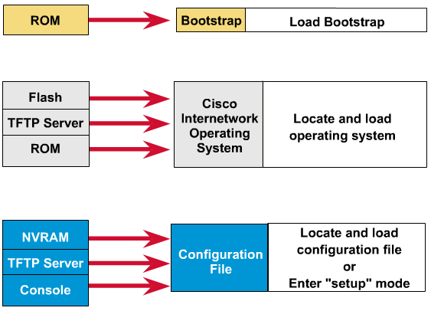
Initial startup of Cisco routers
Notes:
See 2.2.1
After the POST, the following events occur as the router initializes:
Step 1The generic bootstrap loader in ROM executes. A bootstrap is a simple set of instructions that tests hardware and initializes the IOS for operation.
Step 2The IOS can be found in several places. The boot field of the configuration register determines the location to be used in loading the IOS. If the boot field indicates a flash or network load, boot system commands in the configuration file indicate the exact name and location of the image.
Step 3The operating system image is loaded. When the IOS is loaded and operational, a listing of the available hardware and software components is output to the console terminal screen.
Step 4The configuration file saved in NVRAM is loaded into main memory and executed one line at a time. The configuration commands start routing processes, supply addresses for interfaces, and define other operating characteristics of the router.
Step 5 If no valid configuration file exists in NVRAM, the operating system searches for an available TFTP server. If no TFTP server is found, the setup dialog is initiated.

Slide 11
Examining the initial router bootup
System Bootstrap, Version 11.0(10c)XB1, PLATFORM SPECIFIC RELEASE SOFTWARE (fc1)
Copyright (c) 1986-1997 by cisco Systems
2500 processor with 4096 Kbytes of main memory
Notice: NVRAM invalid, possibly due to write erase.
F3: 7532776+107404+573916 at 0x3000060
Restricted Rights Legend
Use, duplication, or disclosure by the Government is
subject to restrictions as set forth in subparagraph
(c) of the Commercial Computer Software - Restricted
Rights clause at FAR sec. 52.227-19 and subparagraph
(c) (1) (ii) of the Rights in Technical Data and Computer
Software clause at DFARS sec. 252.227-7013.
cisco Systems, Inc.
170 West Tasman Drive
San Jose, California 95134-1706
Cisco Internetwork Operating System Software
IOS (tm) 2500 Software (C2500-I-L), Version 12.1(3), RELEASE SOFTWARE (fc1)
Copyright (c) 1986-2000 by cisco Systems, Inc.
Compiled Thu 06-Jul-00 07:33 by cmong
Image text-base: 0x0303E710, data-base: 0x00001000
cisco 2500 (68030) processor (revision D) with 4096K/2048K bytes of memory.
Processor board ID 02440230, with hardware revision 00000000
Bridging software.
X.25 software, Version 3.0.0.
1 Ethernet/IEEE 802.3 interface(s)
2 Serial network interface(s)
32K bytes of non-volatile configuration memory.
8192K bytes of processor board System flash (Read ONLY)
--- System Configuration Dialog ---
Would you like to enter the initial configuration dialog? [yes/no]:
Notes:
See 2.2.3
the statement “NVRAM invalid, possibly due to write erase”, tells the user that this router has not been configured yet or that the NVRAM has been erased.
the user can determine the bootstrap version and the IOS version the router is using as well as the router model, processor, and the amount of memory the router contains. Other information listed in this graphic includes:
The number of interfaces
The types of interfaces
The amount of NVRAM
The amount of flash memory
the user has the option to enter setup mode. Remember, the primary purpose of the setup mode is to permit the administrator to install a minimal configuration for a router, unable to locate a configuration from another source.

Slide 12
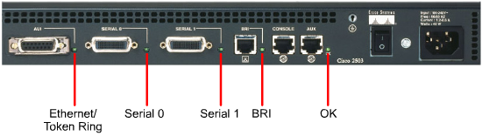
Router LED indicators
Notes:
See 2.2.2

Slide 13
Keyboard help in the router CLI
Router# ?
Exec commands:
access-enable Create a temporary Access-List entry
access-profile Apply user-profile to interface
access-template Create a temporary Access-List entry
archive manage archive files
bfe For manual emergency modes setting
cd Change current directory
clear Reset functions
clock Manage the system clock
--More–
Router# cl?
clear clock
Router# clock ?
set Set the time and date
Router# clock set ?
hh:mm:ss Current Time
Notes:
See 2.2.6
Typing a question mark (?) at the user EXEC mode prompt or the privileged EXEC mode prompt displays a handy list of available commands.
The "--More--" prompt at the bottom of the display indicates that multiple screens are available as output. Whenever a "--More--" prompt appears, the next available screen can be viewed by pressing the space bar. To display just the next line, press the Return or Enter key. Press any other key to return to the prompt.

Slide 14
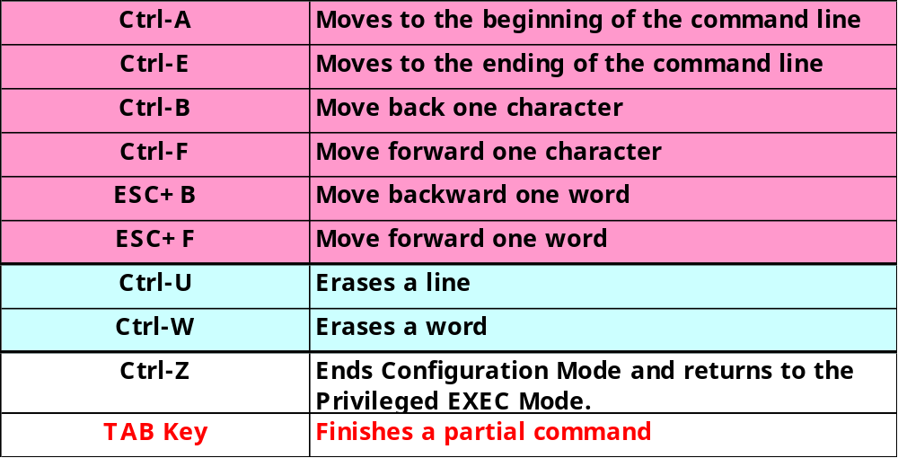
Enhanced editing commands
Notes:
The user interface includes an enhanced editing mode that provides a set of editing key functions that allows the user to edit a command line as it is being typed. The key sequences indicated in Figure can be used to move the cursor on the command line for corrections or changes. Although enhanced editing mode is automatically enabled with the current software release, it can be disabled if it interferes with the interaction of written scripts. To disable enhanced editing mode, type terminal no editing at the privileged EXEC mode prompt.
Ctrl-Z is a command used to back out of configuration mode. This will return the user to the privileged EXEC mode prompt.
The dollar sign ($) indicates that the line has been scrolled to the left.
Ctrl-P or the up arrow key repeatedly to recall successively older commands
Ctrl-N or the down arrow key repeatedly to recall successively more recent commands.
The command history is enabled by default and the system records ten command lines in its history buffer. To change the number of command lines the system records during a terminal session, use the terminal history size or the history size command. The maximum number of commands is 256.
When typing commands, as a shortcut, the unique characters may be entered for a command. Press the Tab key, and the interface will finish the entry.

Slide 15
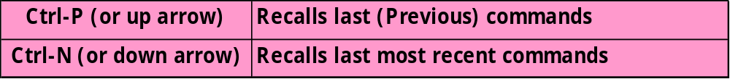
Router command history
By default, history buffer = 10 command lines.
To change the number of command lines
  Router>terminal history size number-of-lines
    Number-of-lines: 1 – 256
Notes:
The command history is enabled by default and the system records ten command lines in its history buffer. To change the number of command lines the system records during a terminal session, use the terminal history size or the history size command. The maximum number of commands is 256.

Slide 16
Troubleshooting command line errors
Router#clock set 16:50:00 2 oct 03
^
% Invalid input detected at '^' marker
Notes:
See 2.2.9
The "^" symbol appears at the point in the command string where an incorrect command, keyword, or argument was entered.

Slide 17
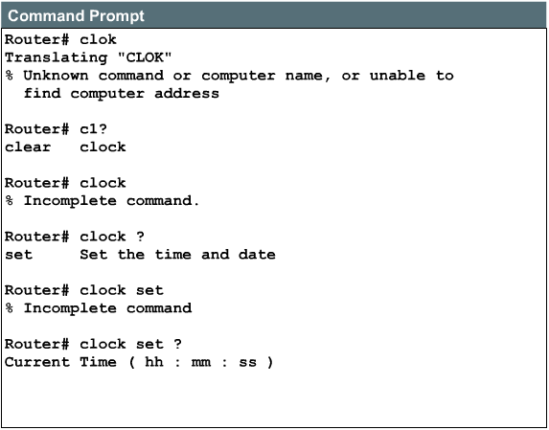
Troubleshooting command line errors

Slide 18
Show version
Cisco Internetwork Operating System Software
IOS (tm) 2500 Software (C2500-IS-L), Version 11.2(14), RELEASE SOFTWARE (fc1)
Copyright (c) 1986-1998 by cisco Systems, Inc.
Compiled Mon 18-May-98 12:43 by tlane
Image text-base: 0x0302F4E4, data-base: 0x00001000
ROM: System Bootstrap, Version 11.0(10c), SOFTWARE
BOOTFLASH: 3000 Bootstrap Software (IGS-BOOT-R), Version 11.0(10c), RELEASE SOFTWARE (fc1)
LAB_A uptime is 0 minutes
System restarted by reload
System image file is "flash:I11214.POO", booted via flash
cisco 2500 (68030) processor (revision N) with 6144K/2048K bytes of memory.
Processor board ID 09218746, with hardware revision 00000000
Bridging software.
X.25 software, Version 2.0, NET2, BFE and GOSIP compliant.
1 Ethernet/IEEE 802.3 interface(s)
2 Serial network interface(s)
32K bytes of non-volatile configuration memory.
8192K bytes of processor board System flash (Read ONLY)
Configuration register is 0x2102
Notes:
See 2.2.10
Figure shows the following information from the show version command:
IOS version and descriptive information
Bootstrap ROM version
Boot ROM version
Router up time
Last restart method
System image file and location
Router platform
Configuration register setting

Slide 19
Show flash
System flash directory:
File Length Name/status
1 5895768 I11214.POO
[5895832 bytes used, 2492776 available, 8388608 total]
8192K bytes of processor board System flash (Read ONLY)

Slide 20

Summary
The basic operation of the IOS
Using the help feature in the command line interface
Using enhanced editing commands
Using command history
Troubleshooting command line errors
Using the show version command

Slide 21

Q&A
Notes:
_________________________________________________________________________
_________________________________________________________________________
_________________________________________________________________________
_________________________________________________________________________
_________________________________________________________________________
_________________________________________________________________________
_________________________________________________________________________
_________________________________________________________________________
_________________________________________________________________________
_________________________________________________________________________
_________________________________________________________________________
_________________________________________________________________________
_________________________________________________________________________
_________________________________________________________________________
_________________________________________________________________________
_________________________________________________________________________
_________________________________________________________________________
_________________________________________________________________________
_________________________________________________________________________

Slide 22
Enjoy the Course
Notes:
_________________________________________________________________________
_________________________________________________________________________
_________________________________________________________________________
_________________________________________________________________________
_________________________________________________________________________
_________________________________________________________________________
_________________________________________________________________________
_________________________________________________________________________
_________________________________________________________________________
_________________________________________________________________________
_________________________________________________________________________
_________________________________________________________________________
_________________________________________________________________________
_________________________________________________________________________
_________________________________________________________________________
_________________________________________________________________________
_________________________________________________________________________
_________________________________________________________________________
_________________________________________________________________________

